Slide 1
Other Deployment Options

Slide 2
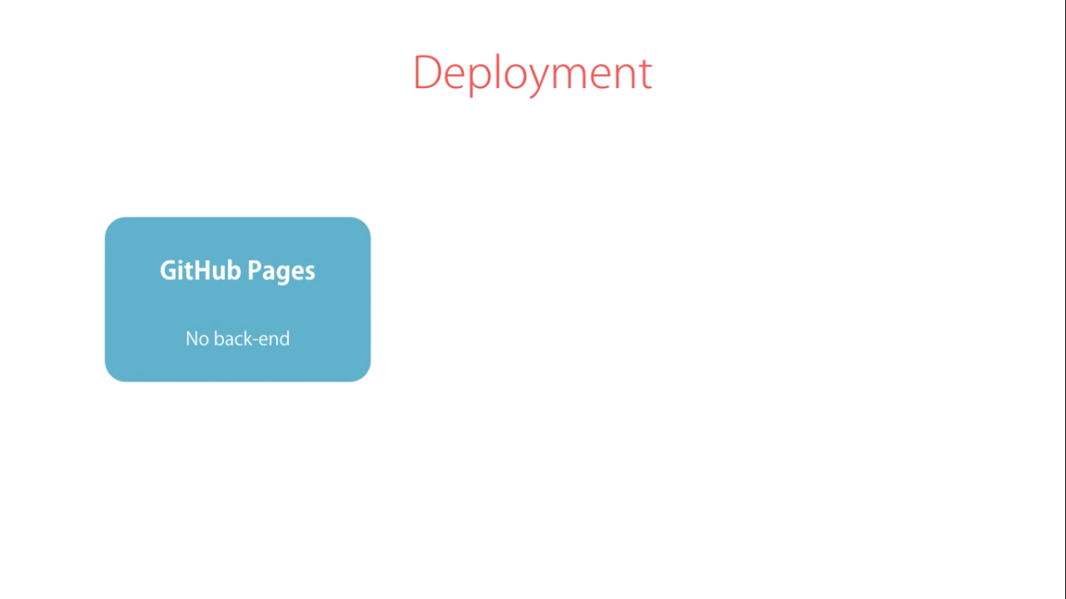

Slide 3
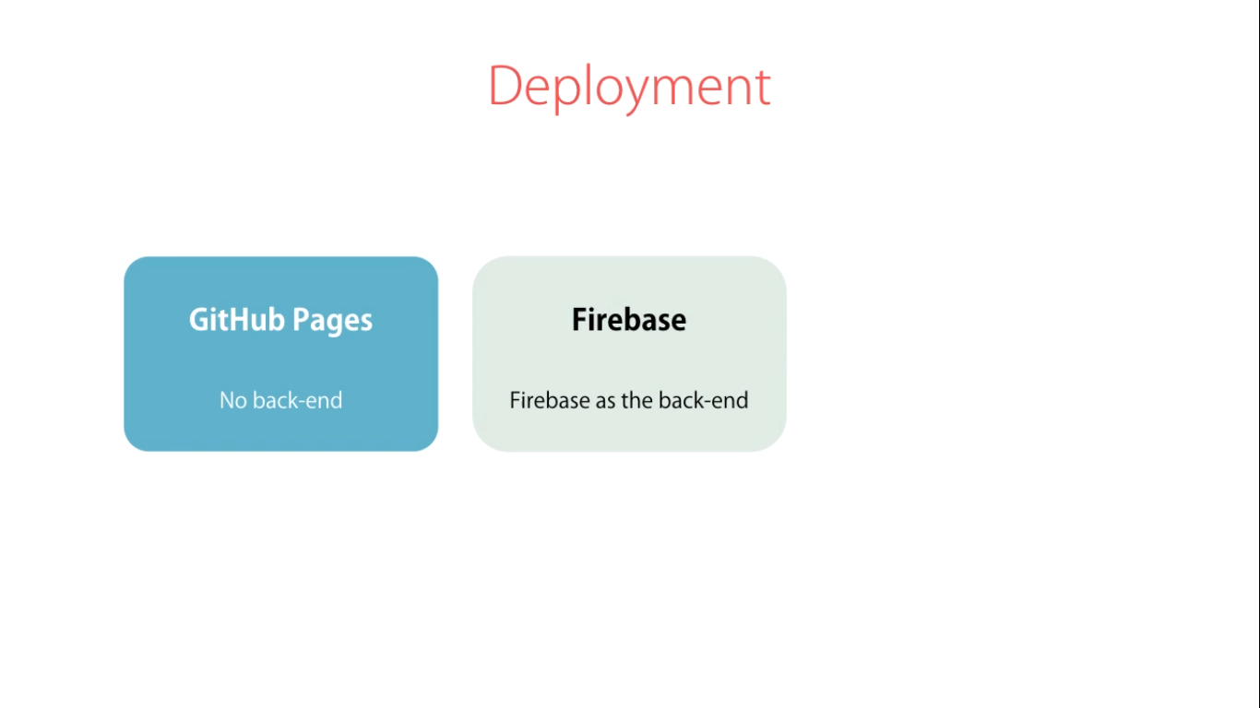

Slide 4
